Slide 1

Soccer Stats
Dataflow
Alejandro Córdoba
Danae Makrygiannis
Luis Fernando Sanchez
Rebeca Cepeda
Andrea Vera
Data Analytics Bootcamp
Octubre 16, 2019

Slide 2
Motivations & Summary
Hypothesis:
Do soccer games have an impact in local beer prices and DUI detentions in certain MTY?
Do soccer games have an impact in deaths and ER emergencias in MTY?
Description:
Us, Mexicans, are passionate about soccer, surveys suggest that over 70% mexicans between 12 and 60 regularly watch soccer games on TV. During this tournaments legal adults tend to watch the game with pals and beer and enjoy the pleasure of seeing their team win. Having this said, we want to know how much does this event has an effect on certain things such as beer prices, deaths, ER emergencies and DUI detentions.
Notes:
Danae

Slide 3
Questions & Data
Main database: “International football results from 1872 to 2019” from Kaggle (www.kaggle.com)
Do soccer matches have an impact in local beer prices and DUI detentions in certain states?
For this hypothesis we wanted to gather data from local prices, so we surfed the web and found PROFECO had a CSV file from 2010 a 2015 with local product prices, on the other hand for the DUI data we used our government database. Having both of this CSVs we search for correlations between soccer tournaments by date vs prices / DUI detentions.
Do soccer matches have an impact in deaths and ER emergencies by state?
For our second hypothesis we had to find trustfull data for ER emergencies and deaths, both are CSV files which needed some cleaning, we were able to find them on our government database.
Notes:
Danae

Slide 4
Data Cleanup & Exploration
Exploration and cleanup process:
Before beginning the exploration, we discussed as a team possible topics we would like to talk about. After exploring the data availability, we decided to talk about soccer matches and their influence on different aspects.
Then we began to gather data sets from the government and Profeco and equalize the data format to create a merge between the files to identify possible correlations in the data.
The deaths catalog had more than 10 dictionaries that were necessary to understand before ingesting the data. They came in handy when replacing coded information on the deaths catalog using key:value pairs.
Adding to the usual merge, it was also necessary to identify values between 2 DataFrames, and create a new column in the master DataFrame acknowledging the existence or non existence of such value in the other table and coding it with 1 or 0.
Notes:
ALE

Slide 5
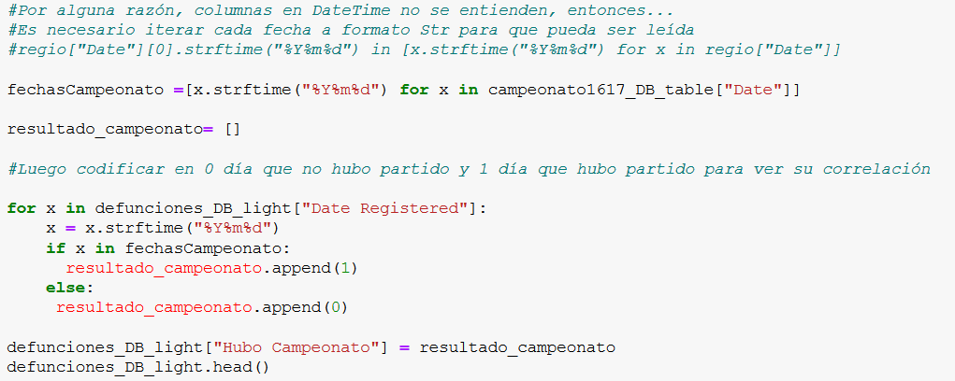
Data Cleanup & Exploration
Exploration and cleanup process:
Notes:
ALE

Slide 6
Data Cleanup & Exploration
Problem:
One big problem we had from our main dataset was the date format of the matches, in between the CSV file. We solved this problem by changing the data frame to date format by year/month/day equalizing it to the format of the other datasets.
On the case of beer prices, we noticed that the prices were only weekdays prices (not on a weekend) so we had to make an adjustment , modifying the game dates to week format (week where there was a match). Also there were some irregularities in the data set so we decided to drop those values.
Notes:
ANDREA

Slide 7


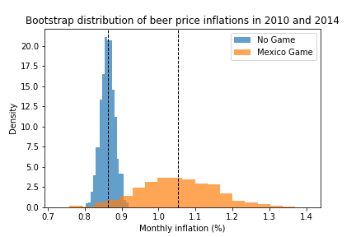
Data Analysis & Discussion
Do FIFA World Cup games have an impact in local beer prices?
Hypothesis:
World Cup games where Mexico plays increase the price of local beers vs. the rest of the games.
Hypothesis not refuted.
On a Mexican game week there is an increase on the beer price inflations, although the density when there is no game is higher.
Notes:
BECKY
Important:
Present and discuss interesting figures developed during exploration, ideally with the help of Jupyter Notebook
Discuss the steps you took to analyze the data and answer each question you asked in your proposal
Present and discuss interesting figures developed during analysis, ideally with the help of Jupyter Notebook

Slide 8


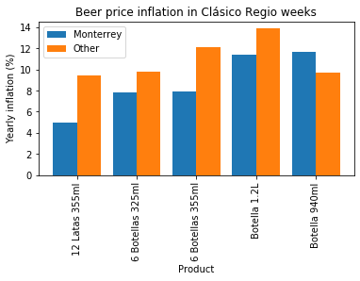
Data Analysis & Discussion
Do “Clasico Regio” have an impact in local beer prices? (size)
VS
Hypothesis:
“Clasico Regio” weeks the price of local beers in Monterrey increases vs. the rest of the cities.
Hypothesis not proved.
In Monterrey, only bottles of 940 ml, also known as “Caguamas”, are the size of beer that has more inflation in Monterrey than the median inflation of other 57 cities in Mexico.
Notes:
BECKY
Important:
Present and discuss interesting figures developed during exploration, ideally with the help of Jupyter Notebook
Discuss the steps you took to analyze the data and answer each question you asked in your proposal
Present and discuss interesting figures developed during analysis, ideally with the help of Jupyter Notebook

Slide 9
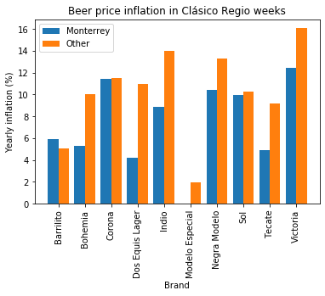
Data Analysis & Discussion
Do “Clasico Regio” have an impact in local beer prices? (brand)
VS
Hypothesis:
“Clasico Regio” weeks the price of local beers in Monterrey increases vs. the rest of the cities.
Hypothesis not proved.
Analyzing by brands, we identified that the “local” brands of Monterrey from Cuauhtémoc Moctezuma / Heineken México, such as: Bohemia, Dos Equis Lager and Tecate, have the smallest inflation in Monterrey (apart from Indio and Sol).
Notes:
LUIS
Important:
Present and discuss interesting figures developed during exploration, ideally with the help of Jupyter Notebook
Discuss the steps you took to analyze the data and answer each question you asked in your proposal
Present and discuss interesting figures developed during analysis, ideally with the help of Jupyter Notebook

Slide 10
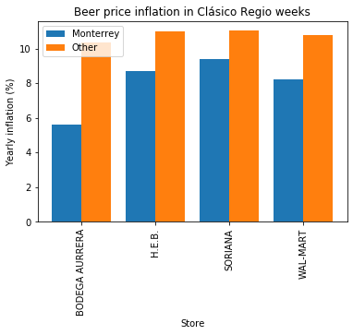
Data Analysis & Discussion
Do “Clasico Regio” have an impact in local beer prices? (store)
VS
Hypothesis:
“Clasico Regio” weeks the price of local beers in Monterrey increases vs. the rest of the cities.
Hypothesis not proved.
Beer prices on stores is relatively lower in Monterrey than in other cities.
Notes:
LUIS
Important:
Present and discuss interesting figures developed during exploration, ideally with the help of Jupyter Notebook
Discuss the steps you took to analyze the data and answer each question you asked in your proposal
Present and discuss interesting figures developed during analysis, ideally with the help of Jupyter Notebook

Slide 11
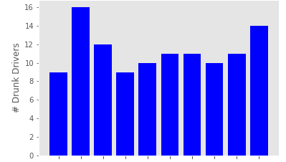
Data Analysis & Discussion
Do soccer games have an impact in local DUI detentions in MTY?
Drunk Drivers Daily Average by Month in Monterrey 2014
Hypothesis:
World Cup games increase the number of drunk drivers vs . the rest of the months
Hypothesis not proved.
Although there is an increase during june 2014, there are other months that have a higher number of drunk drivers
Jan
Feb
Mar
Apr
May
Jun
Jul
Aug
Sept
Oct
Notes:
ANDREA
Important:
Present and discuss interesting figures developed during exploration, ideally with the help of Jupyter Notebook
Discuss the steps you took to analyze the data and answer each question you asked in your proposal
Present and discuss interesting figures developed during analysis, ideally with the help of Jupyter Notebook

Slide 12
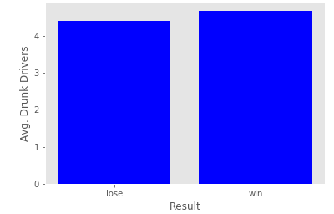
Data Analysis & Discussion
Do soccer games have an impact in local DUI detentions in MTY?
Average drunk drivers when MX loses vs. when MX wins (2013 - 2014)
Hypothesis:
When Mexico wins the number of drunk drivers increases
Hypothesis not refuted.
The number of drunk drivers when Mexico wins a match increases by 6%
Notes:
ANDREA
Important:
Present and discuss interesting figures developed during exploration, ideally with the help of Jupyter Notebook
Discuss the steps you took to analyze the data and answer each question you asked in your proposal
Present and discuss interesting figures developed during analysis, ideally with the help of Jupyter Notebook

Slide 13
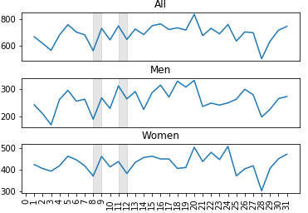
Data Analysis & Discussion
Do soccer matches have an impact in ER emergencies?
Medical Emergencies in Nuevo León in May 2013
Hypothesis:
“Liguilla” games increase the number of ER emergencies vs . when there is no game.
Hypothesis not proved.
When it is game day, the event does not seem to be a factor in the increase of ER emergencies. Even though one day it shows spikes, in the other game day there are actually less emergencies.
Notes:
DANAE
Important:
Present and discuss interesting figures developed during exploration, ideally with the help of Jupyter Notebook
Discuss the steps you took to analyze the data and answer each question you asked in your proposal
Present and discuss interesting figures developed during analysis, ideally with the help of Jupyter Notebook

Slide 14
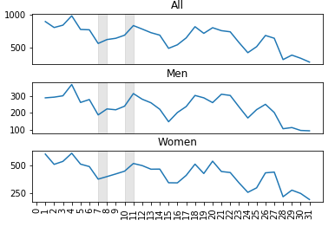
Data Analysis & Discussion
Do soccer matches have an impact in ER emergencies?
Medical Emergencies in Nuevo León in December 2017
Hypothesis:
“Liguilla” games increase the number of ER emergencies vs . when there is no game.
Hypothesis not proved.
When it is game day, the event does not seem to be a factor in the increase of ER emergencies.
Notes:
LUIS
Important:
Present and discuss interesting figures developed during exploration, ideally with the help of Jupyter Notebook
Discuss the steps you took to analyze the data and answer each question you asked in your proposal
Present and discuss interesting figures developed during analysis, ideally with the help of Jupyter Notebook

Slide 15

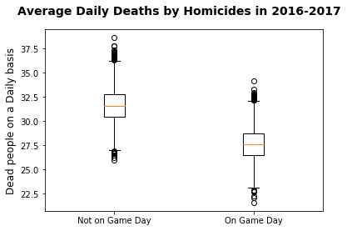
Data Analysis & Discussion
Do soccer games have an impact in deaths by state?
Hypothesis:
Homicides increase nationwide during the season
Hypothesis not refuted
The distribution when there is and there is not a game is constant; therefore, the effects of the event need further analysis.
Notes:
ALE
Important:
Present and discuss interesting figures developed during exploration, ideally with the help of Jupyter Notebook
Discuss the steps you took to analyze the data and answer each question you asked in your proposal
Present and discuss interesting figures developed during analysis, ideally with the help of Jupyter Notebook

Slide 16
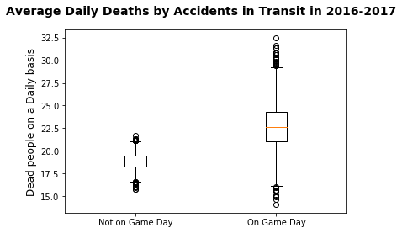
Data Analysis & Discussion
Do soccer games have an impact in deaths by state?
Hypothesis:
Accidents in transit increase nationwide during the season
Hypothesis not refuted
During the season, the distribution of deaths increases, is more varied and dense, however, it could also have the same distribution as not on game day.
Notes:
ALE
Important:
Present and discuss interesting figures developed during exploration, ideally with the help of Jupyter Notebook
Discuss the steps you took to analyze the data and answer each question you asked in your proposal
Present and discuss interesting figures developed during analysis, ideally with the help of Jupyter Notebook

Slide 17
Final Discussion
In our first hypothesis we thought that beer prices would increase during the World Cup and Clasico de Mty, but our findings show that they were lower that the average in other states. On a Mexican game week there is an increase of the beer inflations, although the density when there is no game is higher.
In our second hypothesis we thought there would be a high relationship between ER emergencies and soccer matches, it seems there isn't, just the normal spikes during the whole year. So by this we can say that soccer matches have little or no impact in ER emergencies in Monterrey. Although during the season, the distribution of deaths increases, is more varied than dense, however it could also have the same distribution as not on a game day.
Notes:
ANDREA

Slide 18
Post Mortem
Difficulties:
Since we decided to use very big data sets, some difficulties that arose was the time limit to clean the data to make even more correlations of the information
We would have an hypothesis but take too long to confirm it and realize we might need different information
If we had two more weeks:
If we had already learn how to use SQL, it would have made our data cleaning way faster. That would allow us to make more correlations from the beginning
Masterize graph edition and add labels to bar graphs
* Discuss any additional questions that came up, but which you didn't have time to answer: What would you research next, if you had two more weeks?
Notes:
BECKY

Slide 19
Extras

Slide 20
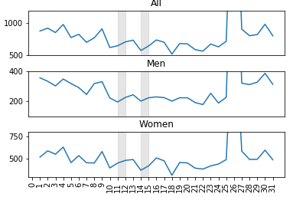
Data Analysis & Discussion
Do soccer matches have an impact in ER emergencies?
Medical Emergencies in Nuevo León in May 2016
Hypothesis:
“Liguilla” games increase the number of ER emergencies vs . when there is no game.
Hypothesis not proved.
When it is game day, the event does not seem to be a factor in the increase of ER emergencies.
Notes:
Important:
Present and discuss interesting figures developed during exploration, ideally with the help of Jupyter Notebook
Discuss the steps you took to analyze the data and answer each question you asked in your proposal
Present and discuss interesting figures developed during analysis, ideally with the help of Jupyter Notebook

Slide 21
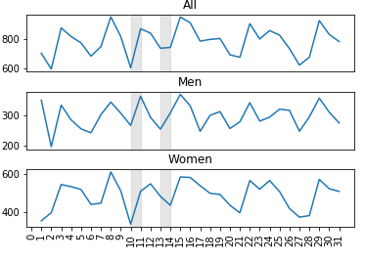
Data Analysis & Discussion
Do soccer matches have an impact in ER emergencies?
Medical Emergencies in Nuevo León in May 2017
Hypothesis:
“Liguilla” games increase the number of ER emergencies vs . when there is no game.
Hypothesis not proved.
...
Notes:
Important:
Present and discuss interesting figures developed during exploration, ideally with the help of Jupyter Notebook
Discuss the steps you took to analyze the data and answer each question you asked in your proposal
Present and discuss interesting figures developed during analysis, ideally with the help of Jupyter Notebook

Slide 22
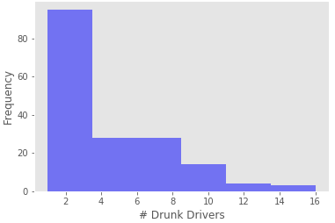
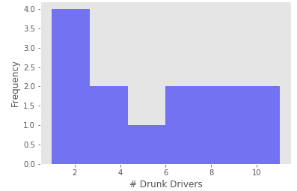
Data Analysis - Extra
Drunk Drivers Histogram 2014
Drunk Drivers Histogram June 2014

